Slide 1
The "Knight's Tour" is an ancient puzzle in which the object is to move a knight, starting from any square on a chessboard, to every other square, landing on each square only once. This is usually considered to be a very challenging puzzle. Try completing the tour in 63 moves. Make legal knight moves on the chessboard below by clicking on each square, starting from the upper left square.

Slide 2
To represent the knight’s tour problem as a graph we will use the following two ideas: Each square on the chessboard can be represented as a node in the graph. Each legal move by the knight can be represented as an edge in the graph. Figure 1 illustrates the legal moves by a knight and the corresponding edges in a graph.

Slide 3
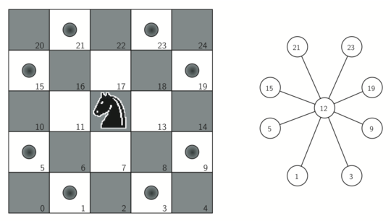

Slide 4
Figure 2 shows the complete graph of possible moves on an eight-by-eight board. There are exactly 336 edges in the graph. Notice that the vertices corresponding to the edges of the board have fewer connections (legal moves) than the vertices in the middle of the board. Once again we can see how sparse the graph is. If the graph was fully connected there would be 4,096 edges. Since there are only 336 edges, the adjacency matrix would be only 8.2 percent full.

Slide 5
